Slide 1


Slide 2
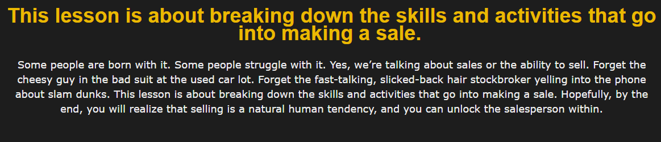

Slide 3
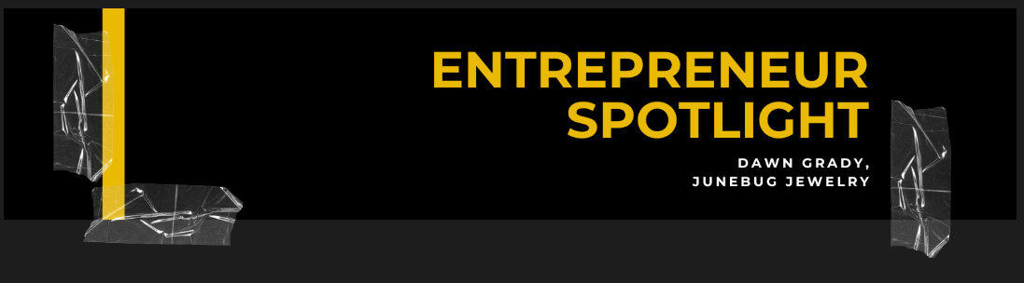

Slide 4
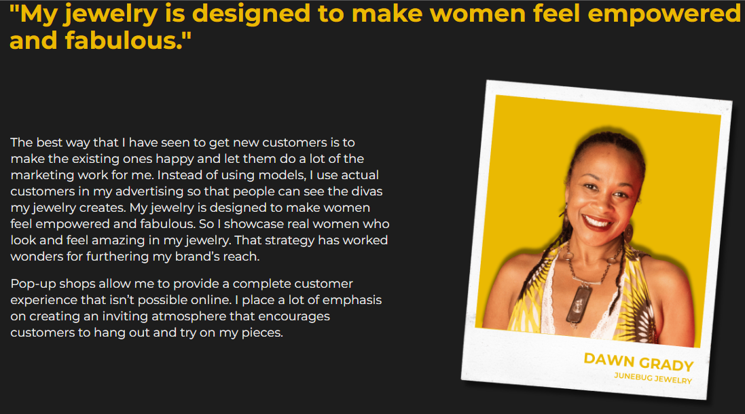
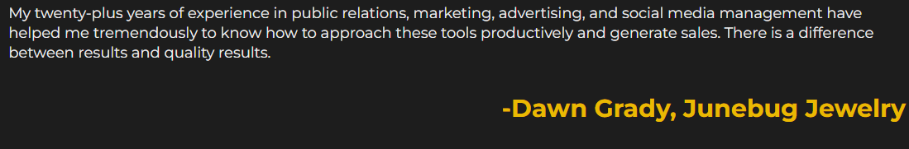

Slide 5
Survey: Write about the most difficult time you had making a sale to someone you didn’t know. What did you have to say or do to get the yes? Why was it so difficult? How did it feel to close the deal?
Submit your assignment
You may only submit one file with maximum 100 MB in size

Slide 6
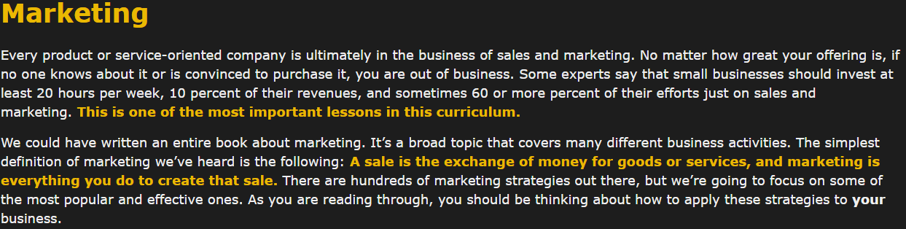

Slide 7
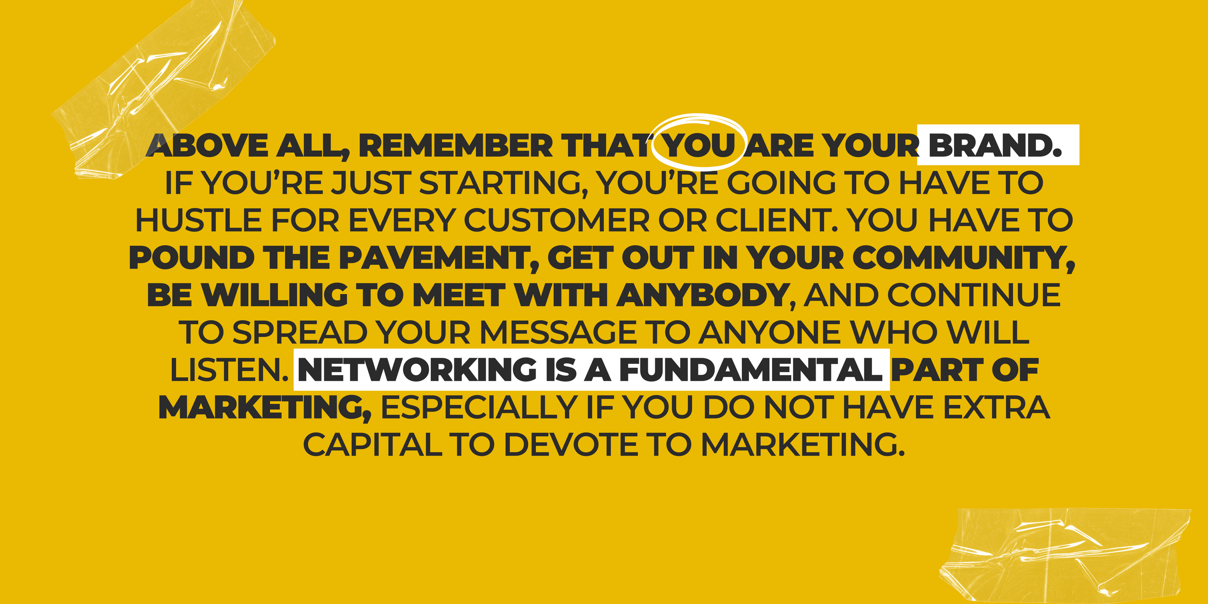

Slide 8
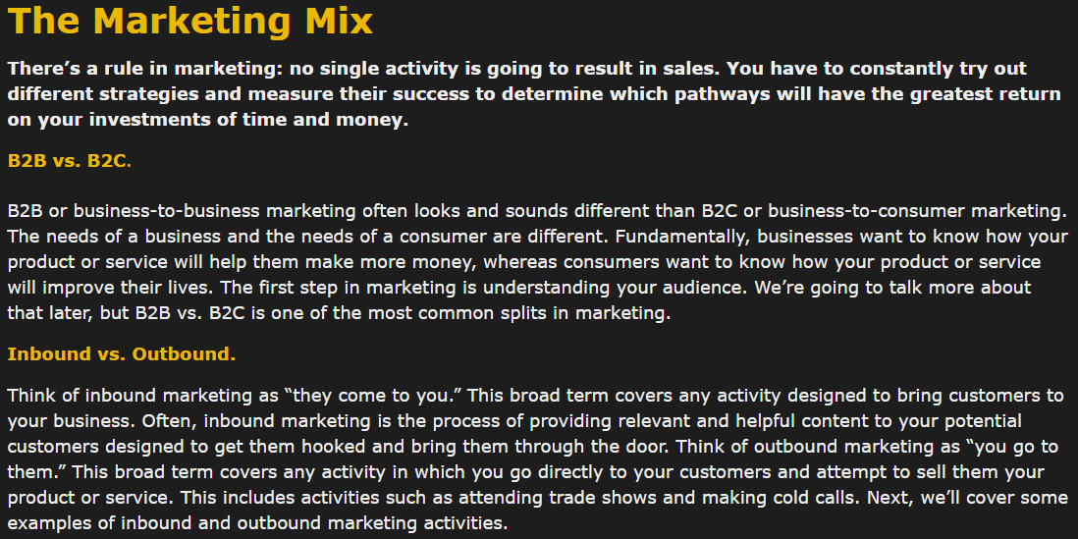

Slide 9
Inbound Marketing

Slide 10
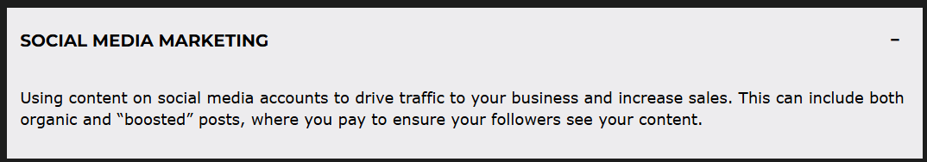

Slide 11
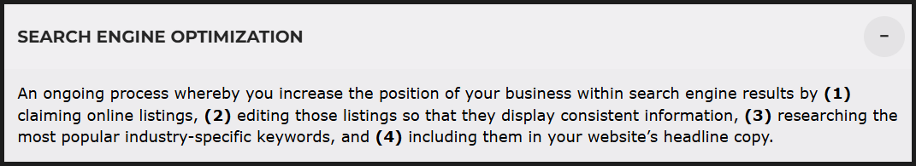

Slide 12
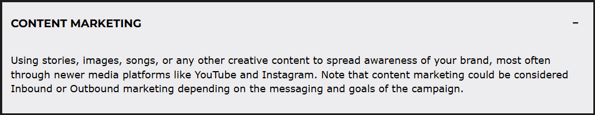

Slide 13
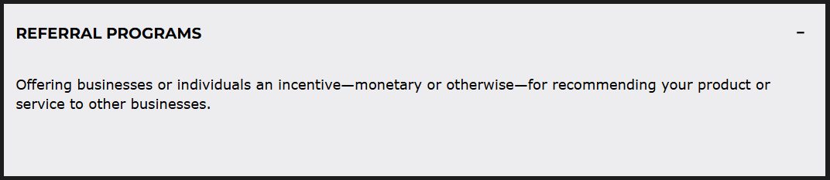

Slide 14
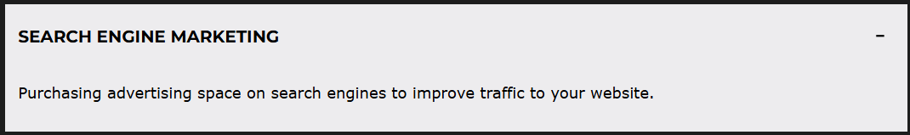

Slide 15
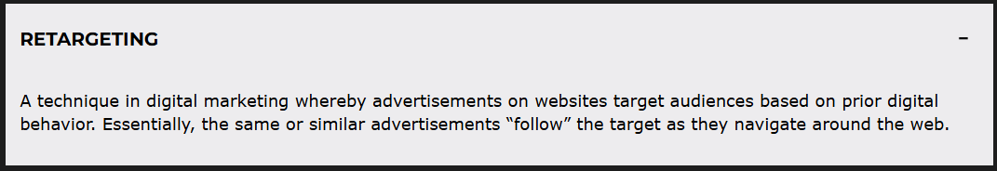

Slide 16
Outbound Marketing

Slide 17
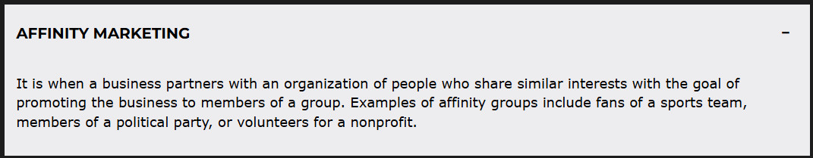

Slide 18
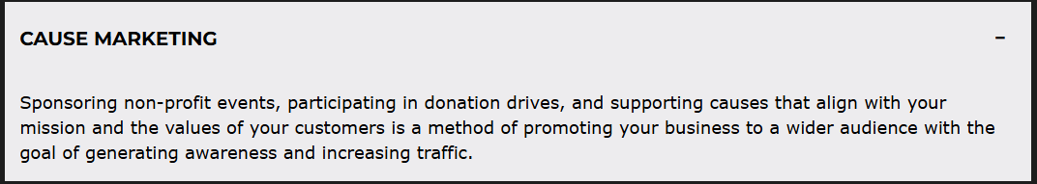

Slide 19
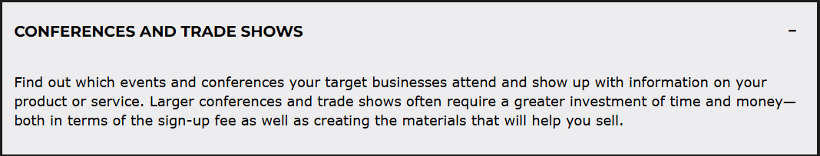

Slide 20
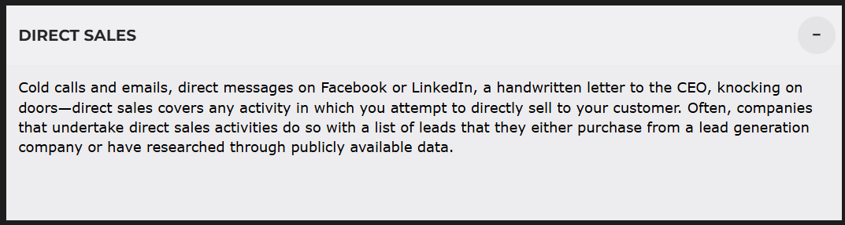

Slide 21
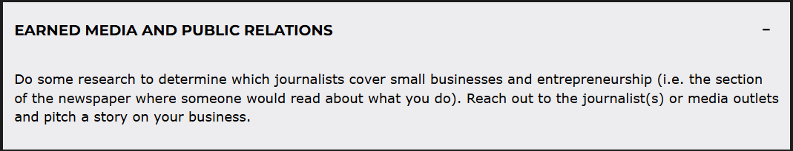

Slide 22
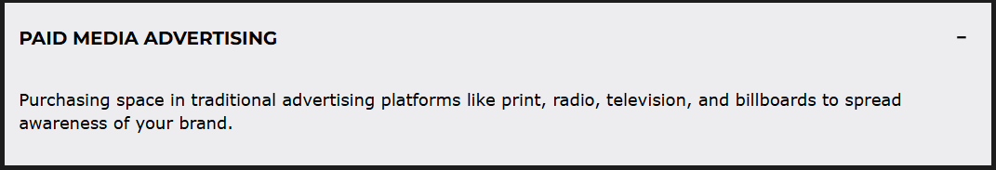

Slide 23
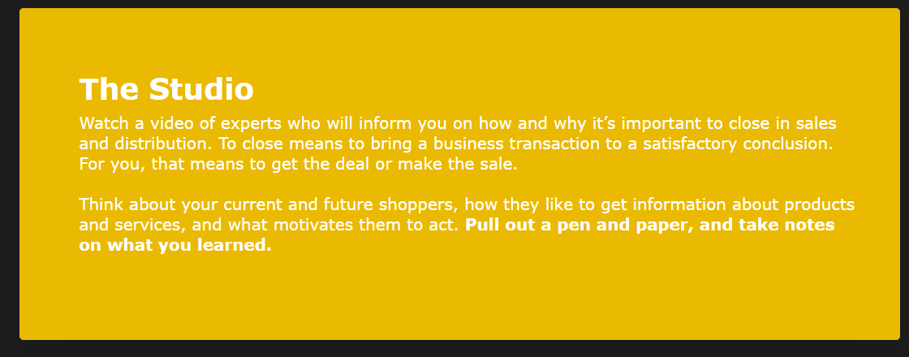

Slide 24


Slide 25
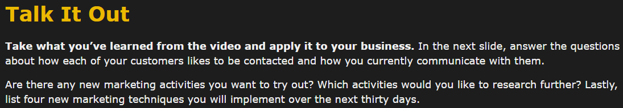

Slide 26
Survey
How my customers want to be reached:
How I reach my customers:
New marketing techniques:

Slide 27
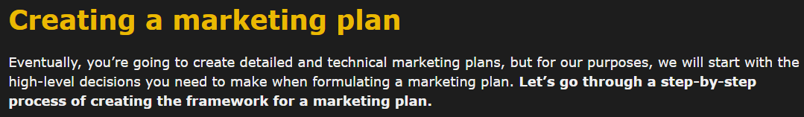


Slide 28
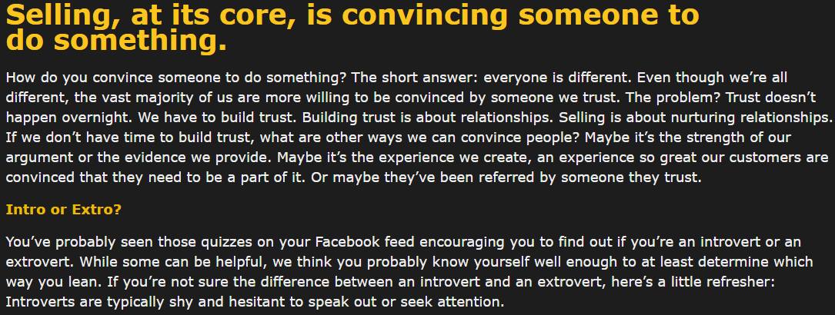
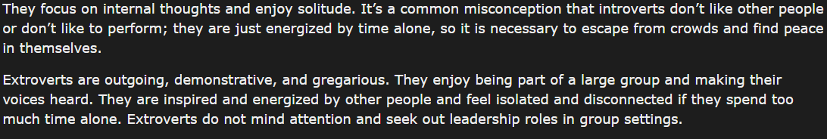

Slide 29
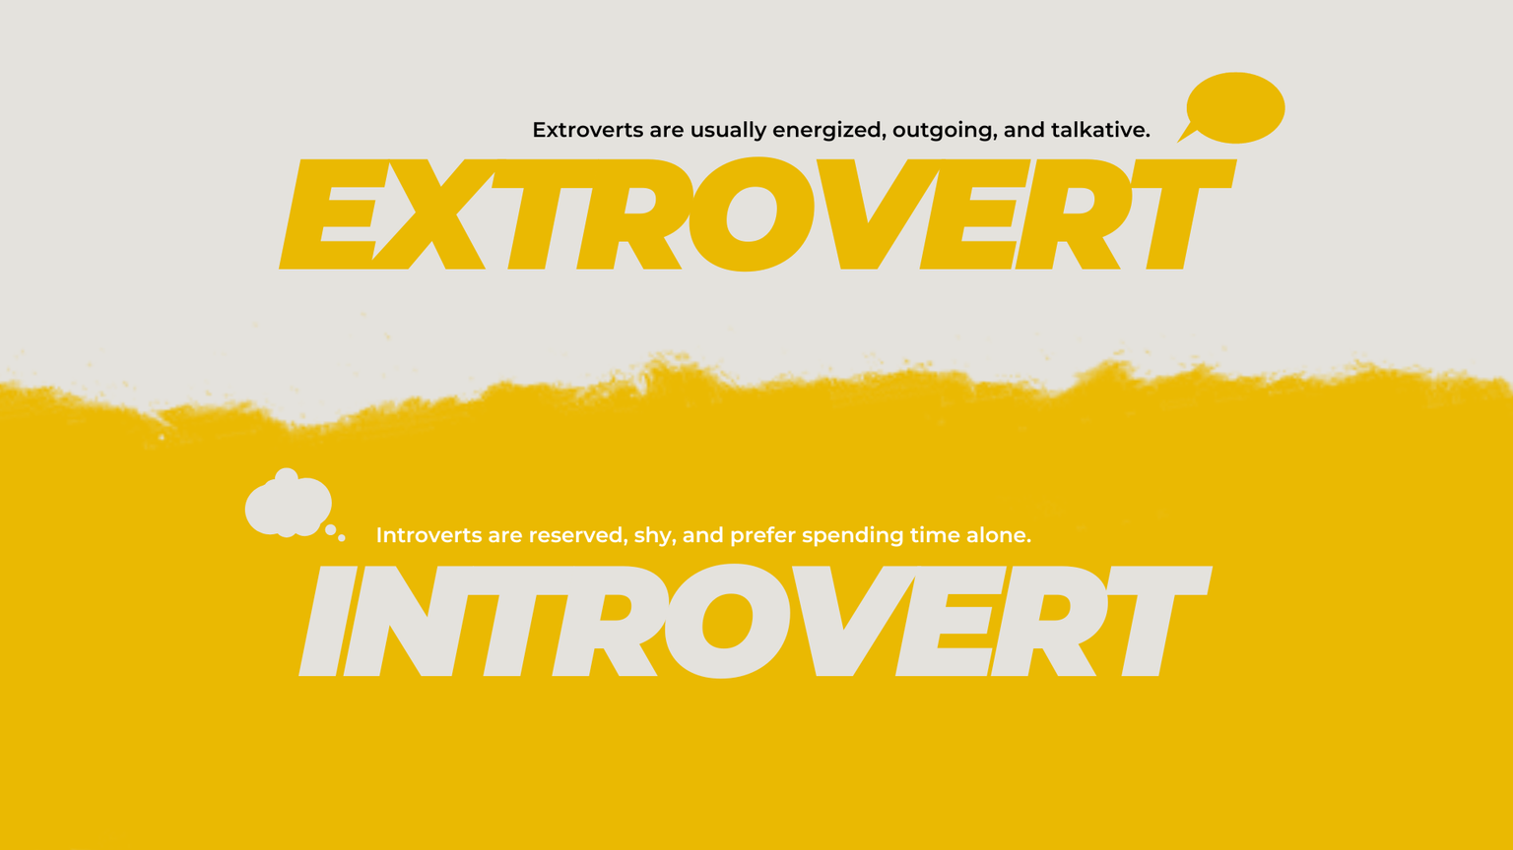

Slide 30
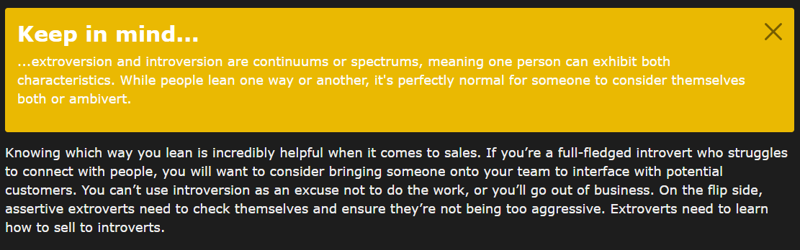

Slide 31
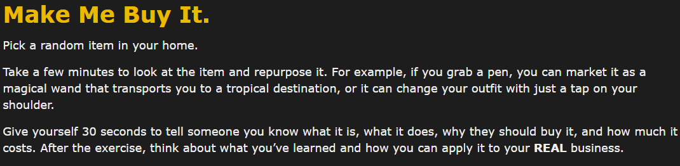


Slide 32
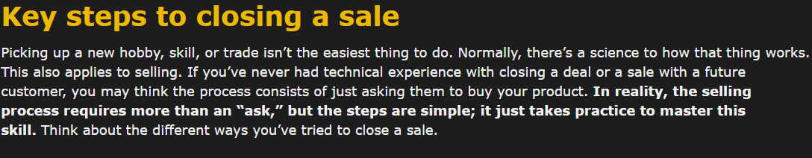

Slide 33
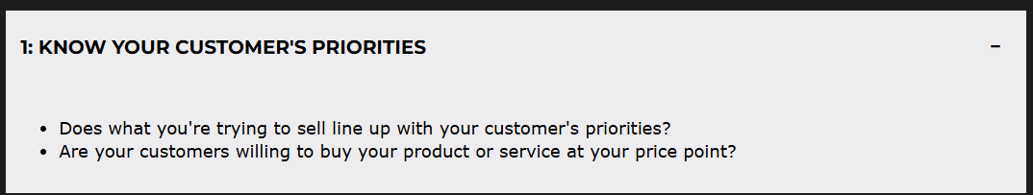

Slide 34
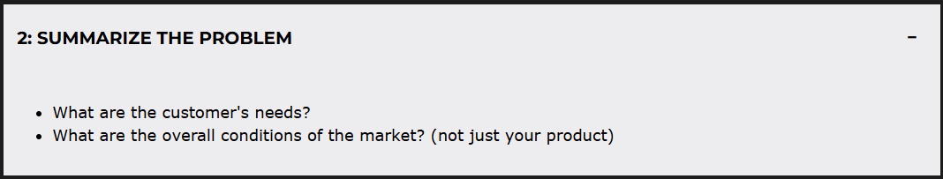

Slide 35
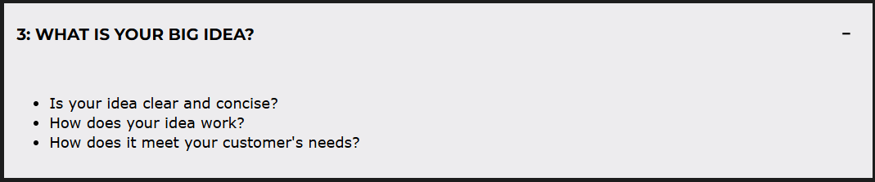

Slide 36
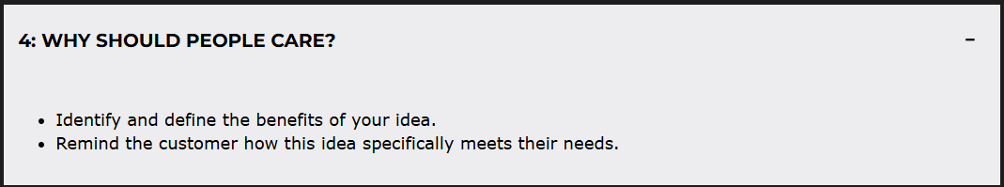

Slide 37
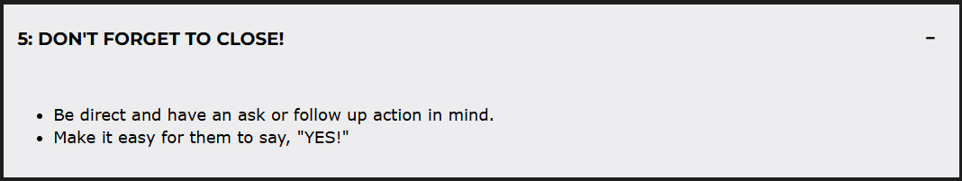

Slide 38


Slide 39
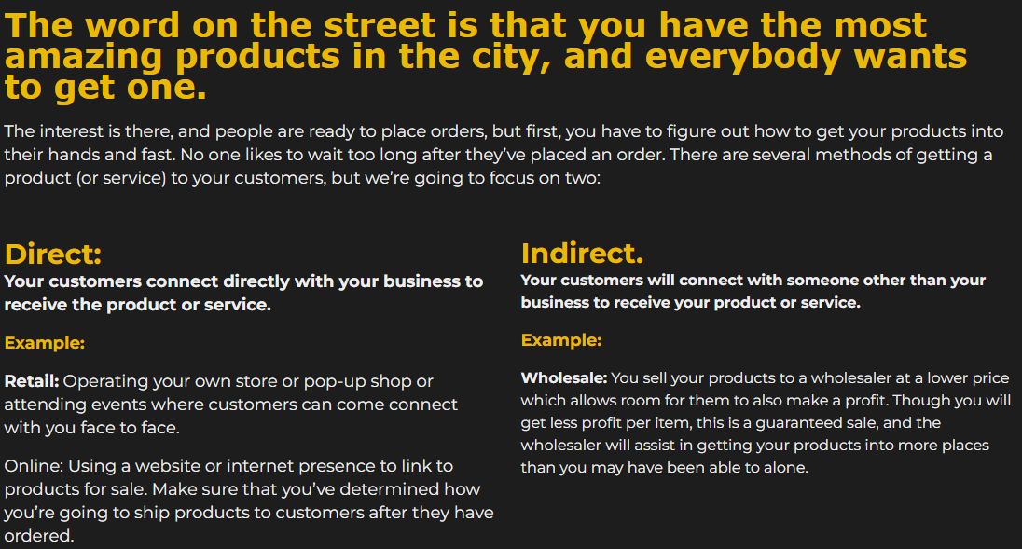

Slide 40
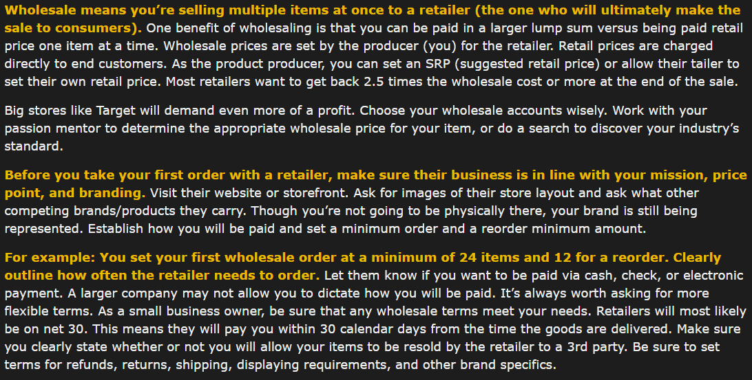
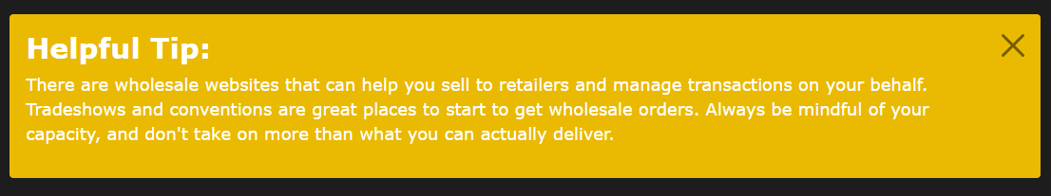

Slide 41
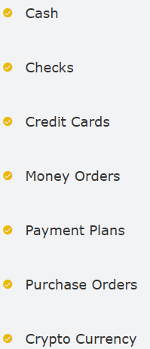
Payment Options
We know payment processors usually take a fee for processing credit card payments, and this can be difficult for small business owners operating on thin margins. A sale of 97 percent is better than no sale at all. Hopefully, this section will give you the lay of the land for payment options and systems. Also, check with your banks! You maybe able to negotiate better credit card processing fees and/or monthly subscription rates.

Slide 42
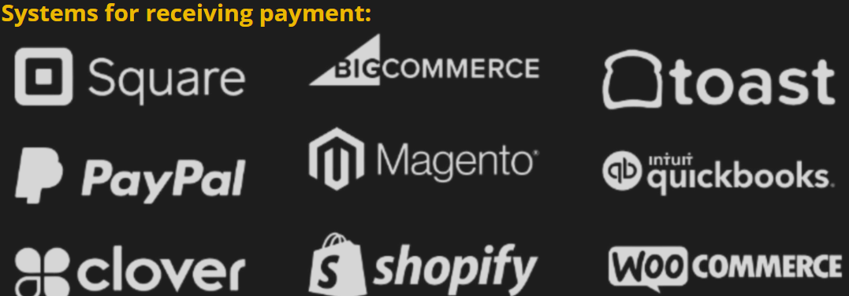

Slide 43
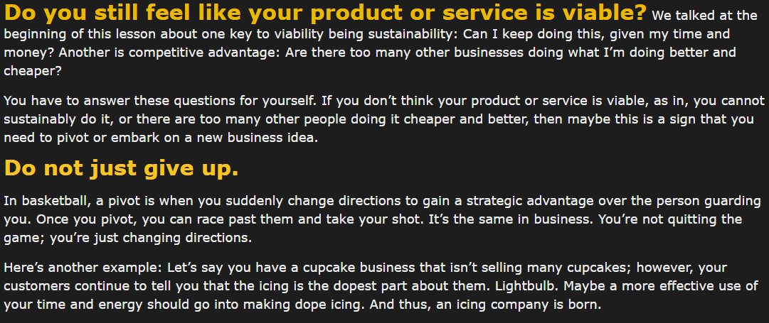

Slide 44
Survey: Reality Check
In your life, was there a time you realized you had to pivot? How did you know? What did you do? Did the pivot improve your life? Why or why not?

Slide 45
Survey: What would you do differently if you had the opportunity to sell again to that difficult customer? How have your feelings about sales and marketing changed? What was the most impactful thing you learned?
Submit your assignment
You may only submit one file with maximum 100 MB in size

Slide 46
Survey: In lesson 6, we had you start crafting your 100-word pitch.
In this lesson, we’re going to turn that message into an elevator pitch. An elevator pitch is exactly what it sounds like: you step into an elevator, and Mark Cuban from the TV show Shark Tank happens to be there. What would you tell him in 60 seconds that might convince him to invest? This elevator pitch should be around 100 words, give or take a few. Practice your elevator pitch in front of the mirror five times a day. Then, pick five people and practice your elevator pitch on them. Write down their feedback
Submit your assignment
You may only submit one file with maximum 100 MB in size

Slide 47
Survey: Build an example, model, or simulation of one of the products or services you offer.
Share it with five to ten people outside of your immediate family and close friends and get feedback. What do they like about it? What questions do they have?
Submit your assignment
You may only submit one file with maximum 100 MB in size

Slide 48
Survey: Business concepts are duplicated day in and day out; that’s why we have many kinds of restaurants, law firms, tech companies, etc.
What helps a business be sustainable is knowing how to separate themselves from their competition. We will go into this next lesson. To prepare for that, write down 5 of your current competitors and 5 of your future competitors.
Submit your assignment
You may only submit one file with maximum 100 MB in size

Slide 49


Slide 50
Survey: Go to your business canvas and answer the corresponding questions on sticky notes in the Sales and Distribution section. Once you’ve done that, type out a paragraph of those responses in your Business Synopsis.
Submit your assignment
You may only submit one file with maximum 100 MB in size

Slide 51
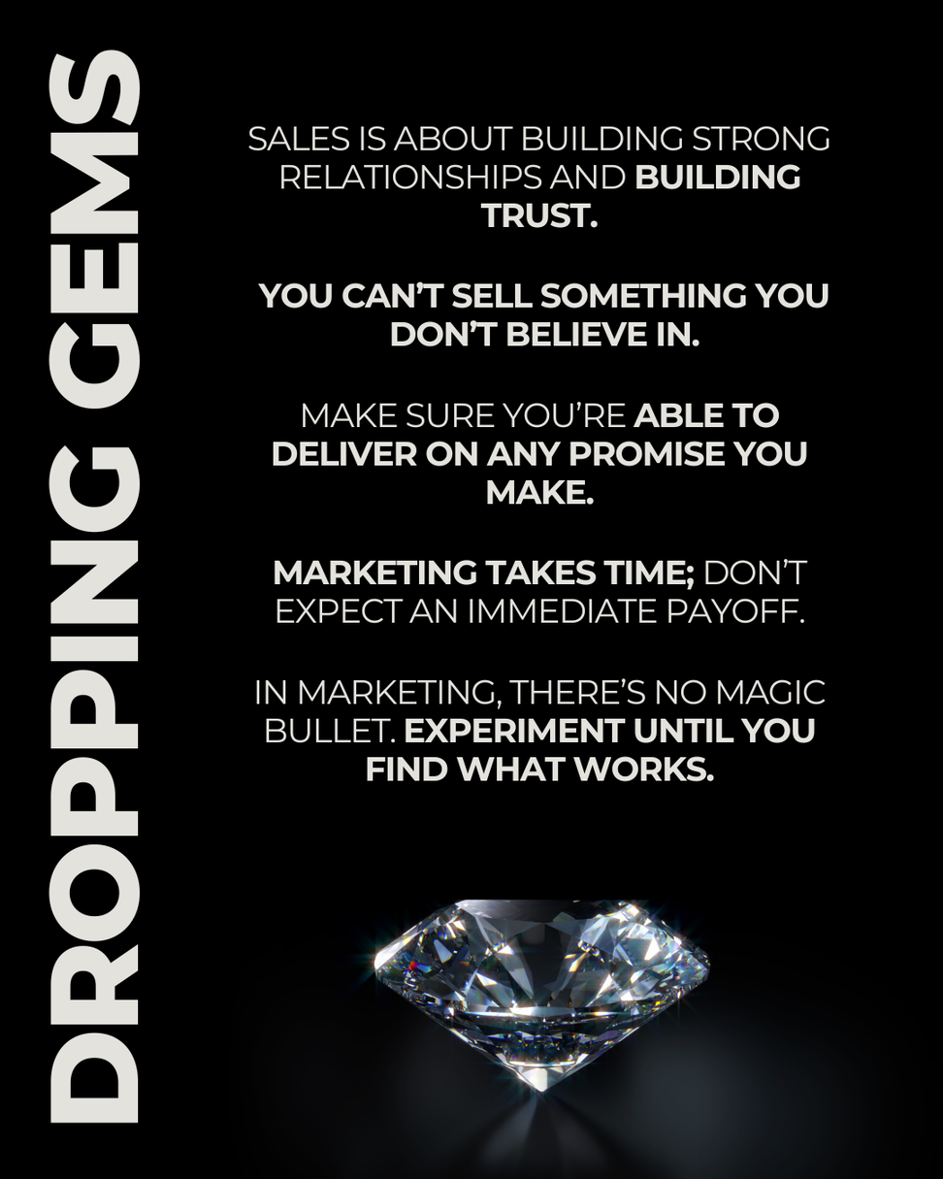

Slide 52
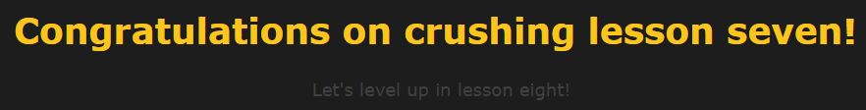

Slide 53
Quiz
Question 1 of 7
Approximately what percentage of revenue should small businesses be spending on sales and marketing, according to some business leaders?
Choose only ONE best answer.
A
2
B
3
C
10
D
20
This answer is correct. - 10 is the correct answer
Retargeting, social media marketing, and referral programs are examples of what type of marketing?
Choose only ONE best answer.
A
Inbound - correct
B
Outbound
This answer is correct.
How do Jim Stahly and Donny Harper, panelists on The Studio, recommend that you keep loyal customers? Select all that apply.
Choose ALL answers that apply.
A
Keep it simple
B
Make a quality product
C
Deliver value to people’s life
D
Recognizing good customers that you already have through something like a rewards program - answer is all of the above
Businesses want to know how your product or service will help them make more money, whereas customers want to know how your product or service will improve their lives.
Choose only ONE best answer.
A
TRUE - correct answer
B
FALSE
What is one of the differences between an introvert and an extrovert?
Choose only ONE best answer.
A
Introverts don’t like being around people while extroverts like being around people
B
Introverts are energized by time alone while extroverts are energized by time with other people. - correct
Attending trade shows, affinity marketing, and making cold calls are examples of what type of marketing?
Choose only ONE best answer.
A
Inbound
B
Outbound - correct
This answer is correct.

